Slide 1
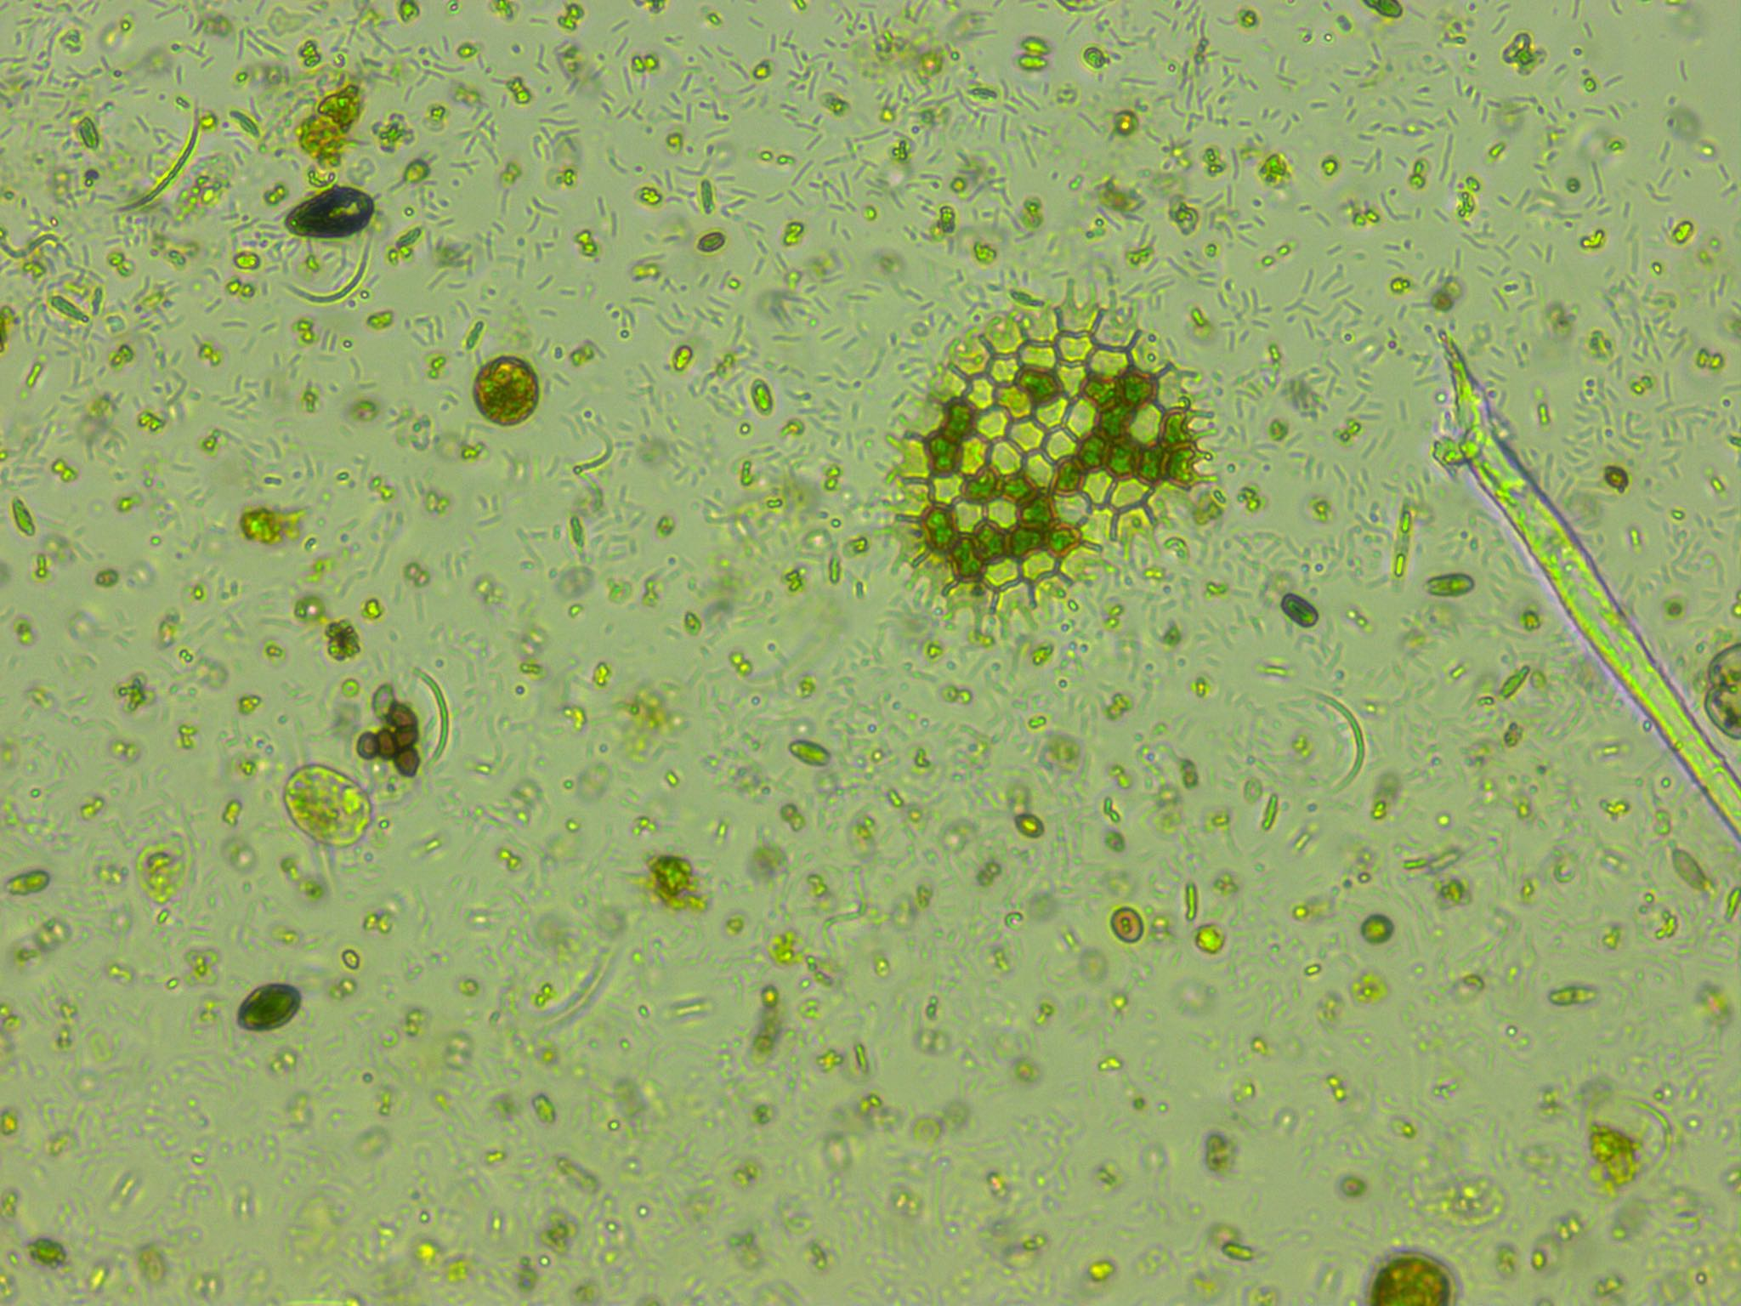
Predicting phytoplankton metabolism from the individual size distribution
Daniel Padfield

Slide 2
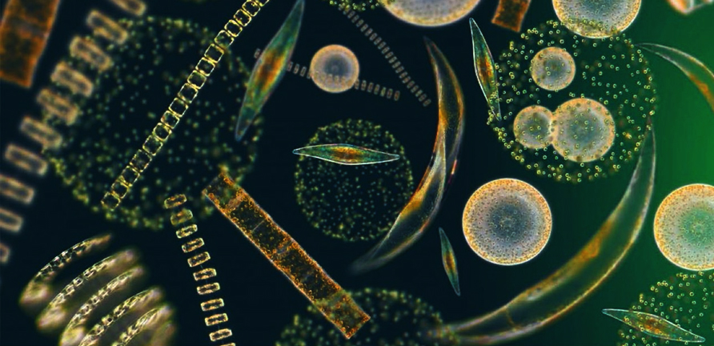
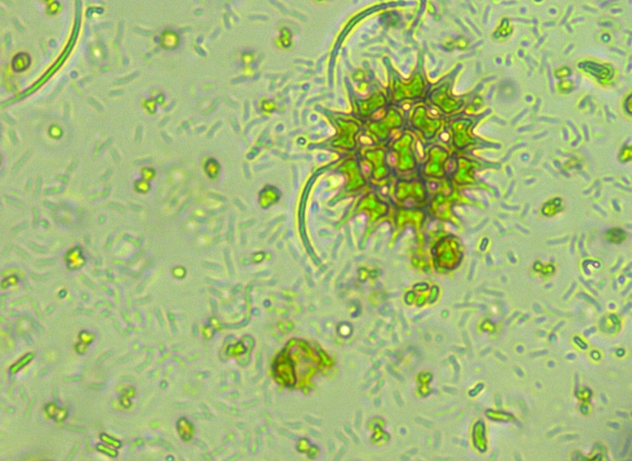
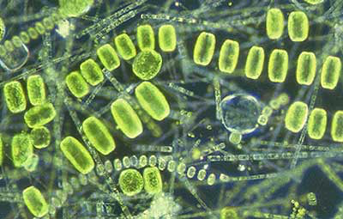
Phytoplankton are key for the carbon cycle
~50% of annual carbon fixation
Fuel entire ocean food webs

Slide 3
Current measurements of metabolism

Slide 4
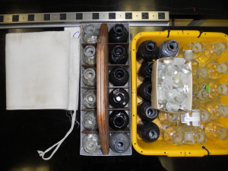
Current measurements of metabolism
Bottle incubations – in vivo
Snapshot in time
Single community
Control over environmental variables

Slide 5
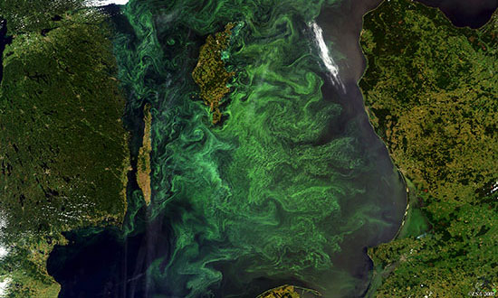
Current measurements of metabolism
Bottle incubations – in vivo
Gas measurements – in situ
Snapshot in time
Single community
Control over environmental variables
Integrates over large areas
Many communities and many different environmental conditions

Slide 6

Current measurements of metabolism
Bottle incubations – in vivo
Gas measurements – in situ
Total photosynthesis < total respiration
Total photosynthesis > total respiration

Slide 7

Crash course in metabolic theory

Slide 8

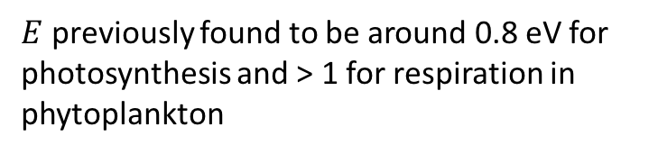
Crash course in metabolic theory
$$e^{\left.E(\frac{1}{kT_{c}}−\frac{1}{kT}\right)}$$
$E$ previously found to be around 0.8 eV for photosynthesis and > 1 for respiration in phytoplankton
🔥🔥🔥🔥🔥🔥🔥

Slide 9
Crash course in metabolic theory

Slide 10

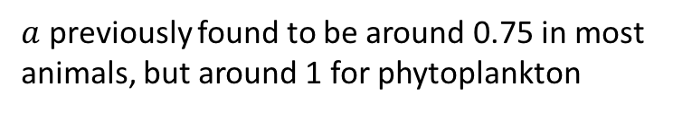
Crash course in metabolic theory
$$m_{i}^{a}$$
$a$ previously found to be around 0.75 in most animals, but around 1 for phytoplankton

Slide 11
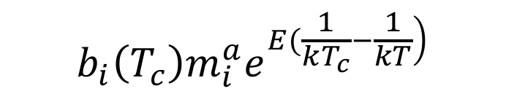
Crash course in metabolic theory
$$b_{i}\left(T_{c}\right)m_{i}^{a}e^{\left.E(\frac{1}{kT_{c}}−\frac{1}{kT}\right)}$$
🔥🔥🔥🔥🔥🔥🔥
🔥🔥🔥🔥🔥🔥🔥

Slide 12
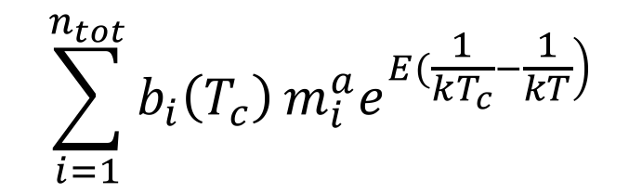
Crash course in metabolic theory
$$\sum_{i=1}^{n_{tot}}{b_{i}\left(T_{c}\right)}m_{i}^{a}e^{\left.E(\frac{1}{kT_{c}}−\frac{1}{kT}\right)}$$

Slide 13
Crash course in metabolic theory
$$\sum_{i=1}^{n_{tot}}{b_{i}\left(T_{c}\right)}m_{i}^{a}e^{\left.E(\frac{1}{kT_{c}}−\frac{1}{kT}\right)}$$
🔥🔥🔥
🔥🔥🔥🔥🔥🔥🔥🔥🔥🔥🔥🔥🔥🔥

Slide 14
Zero-sum dynamics

Slide 15
Zero-sum dynamics
🔥🔥🔥
🔥🔥🔥
🔥🔥🔥
🔥🔥🔥
🔥🔥🔥
🔥🔥🔥
🔥🔥🔥
🔥🔥🔥
🔥🔥🔥
Average individual metabolic rate

Slide 16
Zero-sum dynamics
Average individual metabolic rate

Slide 17
Zero-sum dynamics
🔥🔥🔥
🔥🔥🔥
🔥🔥🔥
Average individual metabolic rate
Total
abundance

Slide 18
Predictions
Predict community metabolic rates from the size- and temperature-dependence of individuals in the size distribution
Across-communities, there will be a trade off between total abundance and average individual metabolic rate
Trade offs between community properties may impact community flux

Slide 19
Experimental setup
10 years warming : half 4ºC above ambient

Slide 20
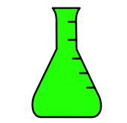
Experimental setup
How do the communities and their functioning change in response to long-term and short-term warming
10 years warming : half 4ºC above ambient
Cool incubator ~ 4 weeks
Warm incubator ~ 4 weeks

Slide 21
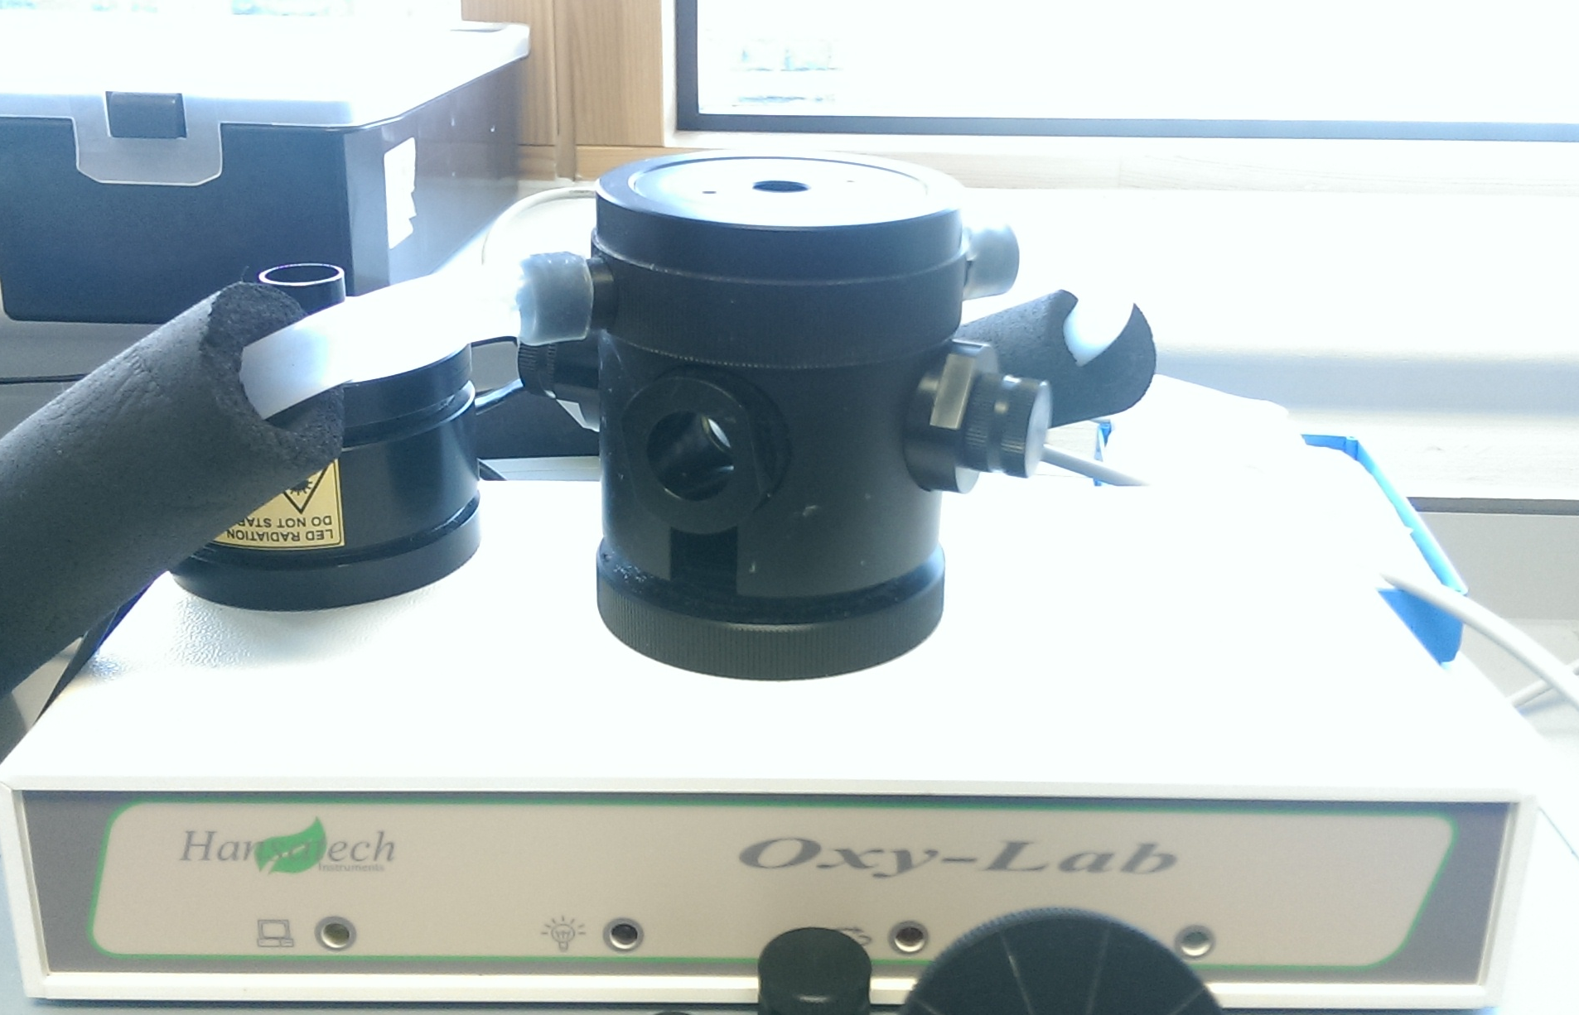
Measurements
+
Metabolism @ incubator temperature
1 point for each microcosm
Size distribution
> 300 points per sample!

Slide 22
Long-term warming changes communities

Slide 23
No difference in measured raw metabolism
Community flux
Community flux

Slide 24
No difference in measured raw metabolism
Community flux
Community flux

Slide 25
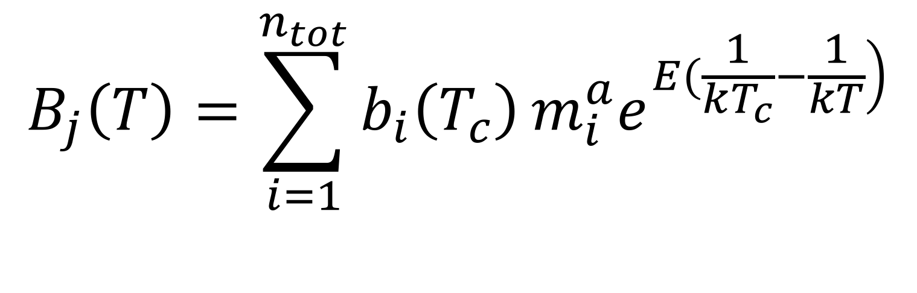
Model
$$B_{j}\left(T\right)=\sum_{i=1}^{n_{tot}}{b_{i}\left(T_{c}\right)}m_{i}^{a}e^{\left.E(\frac{1}{kT_{c}}−\frac{1}{kT}\right)}$$

Slide 26
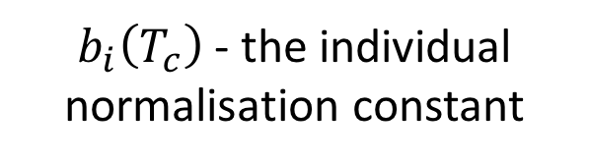
Model
$$B_{j}\left(T\right)=\sum_{i=1}^{n_{tot}}{b_{i}\left(T_{c}\right)}m_{i}^{a}e^{\left.E(\frac{1}{kT_{c}}−\frac{1}{kT}\right)}$$
$b_{i}\left(T_{c}\right)$ - the individual normalisation constant

Slide 27
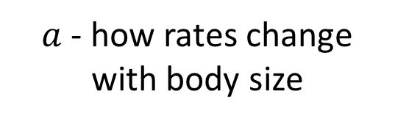
Model
$a$ - how rates change with body size
$$B_{j}\left(T\right)=\sum_{i=1}^{n_{tot}}{b_{i}\left(T_{c}\right)}m_{i}^{a}e^{\left.E(\frac{1}{kT_{c}}−\frac{1}{kT}\right)}$$

Slide 28
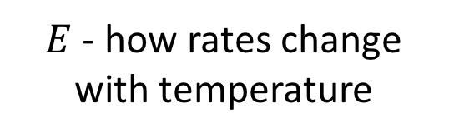
Model
$$B_{j}\left(T\right)=\sum_{i=1}^{n_{tot}}{b_{i}\left(T_{c}\right)}m_{i}^{a}e^{\left.E(\frac{1}{kT_{c}}−\frac{1}{kT}\right)}$$
$E$ - how rates change with temperature

Slide 29
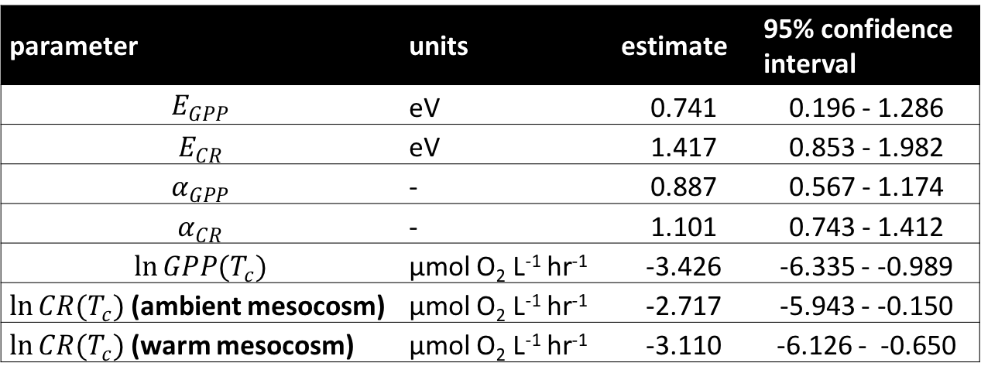
Model predicts size and temperature-dependence
parameter | units | estimate | 95% confidence interval
$$E_{GPP}$$ | eV | 0.741 | 0.196 - 1.286
$$E_{CR}$$ | eV | 1.417 | 0.853 - 1.982
$$α_{GPP}$$ | - | 0.887 | 0.567 - 1.174
$$α_{CR}$$ | - | 1.101 | 0.743 - 1.412
$$\ln{GPP(T_{c})}$$ | µmol O₂ L⁻¹ hr⁻¹ | -3.426 | -6.335 - -0.989
$\ln{CR(T_{c})}$ (ambient mesocosm) | µmol O₂ L⁻¹ hr⁻¹ | -2.717 | -5.943 - -0.150
$\ln{CR(T_{c})}$ (warm mesocosm) | µmol O₂ L⁻¹ hr⁻¹ | -3.110 | -6.126 - -0.650

Slide 30
Model predicts size and temperature-dependence
parameter | units | estimate | 95% confidence interval
$$E_{GPP}$$ | eV | 0.741 | 0.196 - 1.286
$$E_{CR}$$ | eV | 1.417 | 0.853 - 1.982
$$α_{GPP}$$ | - | 0.887 | 0.567 - 1.174
$$α_{CR}$$ | - | 1.101 | 0.743 - 1.412
$$\ln{GPP(T_{c})}$$ | µmol O₂ L⁻¹ hr⁻¹ | -3.426 | -6.335 - -0.989
$\ln{CR(T_{c})}$ (ambient mesocosm) | µmol O₂ L⁻¹ hr⁻¹ | -2.717 | -5.943 - -0.150
$\ln{CR(T_{c})}$ (warm mesocosm) | µmol O₂ L⁻¹ hr⁻¹ | -3.110 | -6.126 - -0.650

Slide 31
Model predicts size and temperature-dependence
parameter | units | estimate | 95% confidence interval
$$E_{GPP}$$ | eV | 0.741 | 0.196 - 1.286
$$E_{CR}$$ | eV | 1.417 | 0.853 - 1.982
$$α_{GPP}$$ | - | 0.887 | 0.567 - 1.174
$$α_{CR}$$ | - | 1.101 | 0.743 - 1.412
$$\ln{GPP(T_{c})}$$ | µmol O₂ L⁻¹ hr⁻¹ | -3.426 | -6.335 - -0.989
$\ln{CR(T_{c})}$ (ambient mesocosm) | µmol O₂ L⁻¹ hr⁻¹ | -2.717 | -5.943 - -0.150
$\ln{CR(T_{c})}$ (warm mesocosm) | µmol O₂ L⁻¹ hr⁻¹ | -3.110 | -6.126 - -0.650

Slide 32
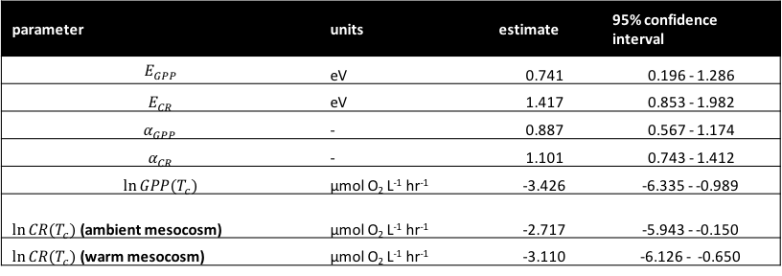
Predicted vs Observed flux
parameter | units | estimate | 95% confidence interval
$$E_{GPP}$$ | eV | 0.741 | 0.196 - 1.286
$$E_{CR}$$ | eV | 1.417 | 0.853 - 1.982
$$α_{GPP}$$ | - | 0.887 | 0.567 - 1.174
$$α_{CR}$$ | - | 1.101 | 0.743 - 1.412
$$\ln{GPP(T_{c})}$$ | µmol O₂ L⁻¹ hr⁻¹ | -3.426 | -6.335 - -0.989
$\ln{CR(T_{c})}$ (ambient mesocosm) | µmol O₂ L⁻¹ hr⁻¹ | -2.717 | -5.943 - -0.150
$\ln{CR(T_{c})}$ (warm mesocosm) | µmol O₂ L⁻¹ hr⁻¹ | -3.110 | -6.126 - -0.650

Slide 33

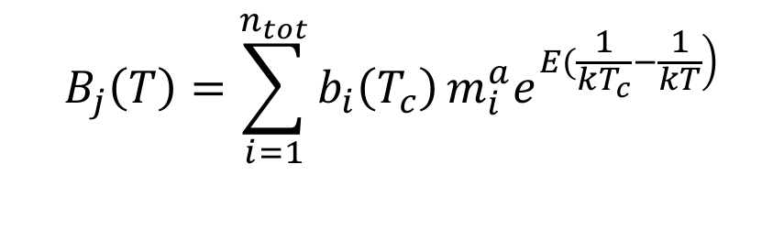
Predicted vs Observed flux
parameter | units | estimate | 95% confidence interval
$$E_{GPP}$$ | eV | 0.741 | 0.196 - 1.286
$$E_{CR}$$ | eV | 1.417 | 0.853 - 1.982
$$α_{GPP}$$ | - | 0.887 | 0.567 - 1.174
$$α_{CR}$$ | - | 1.101 | 0.743 - 1.412
$$\ln{GPP(T_{c})}$$ | µmol O₂ L⁻¹ hr⁻¹ | -3.426 | -6.335 - -0.989
$\ln{CR(T_{c})}$ (ambient mesocosm) | µmol O₂ L⁻¹ hr⁻¹ | -2.717 | -5.943 - -0.150
$\ln{CR(T_{c})}$ (warm mesocosm) | µmol O₂ L⁻¹ hr⁻¹ | -3.110 | -6.126 - -0.650
$$+$$
$$B_{j}\left(T\right)=\sum_{i=1}^{n_{tot}}{b_{i}\left(T_{c}\right)}m_{i}^{a}e^{\left.E(\frac{1}{kT_{c}}−\frac{1}{kT}\right)}$$

Slide 34
Model does a pretty good job!
Observed flux
Observed flux
Predicted flux
Predicted flux

Slide 35
Model does a pretty good job!
Observed flux
Observed flux
Predicted flux
Predicted flux

Slide 36
Paradoxical result?
Community flux
Community flux

Slide 37
Zero-sum dynamics
log Total community abundance
Average individual metabolic rate

Slide 38
Zero-sum dynamics
Average individual metabolic rate
Total
abundance
log Total community abundance
Average individual metabolic rate

Slide 39
Conclusions
Linked the metabolic rates of whole communities to the individual size distribution
Flow cytometry routinely taken in scientific ship voyages
As a bonus, validated some key assumptions of metabolic scaling theory

Slide 40
Thanks for listening!

